Slide 1


A Summary of Multi-Robot Planning Methods
David A Smart ENPM 661 – 0101

Slide 2





Motivation
Cost
Reliability
Efficiency
This Photo by Unknown Author is licensed under CC BY-NC
Notes:
Many simple robots may be cheaper than a single complex robot capable of accomplishing the task
If one robot fails, another can replace it
Teams are more efficient in terms of time or energy as they can solve problems synchronously and can cover a larger area
And some problems are simply impossible for any single robot to do
Research in multi-agent systems began in the late 1980s [8].

Slide 3






Terminology
Multi-Robot
Swarm Robotics
20+
Homogeneous
Distributed
“Incapable”
Limited or Implicit
Homogeneous
Heterogeneous
Notes:
At first glance, one may assume that swam robotics is the same as multi-robot systems and admittedly there is a good deal of overlap, however, there are also some key distinctions to be made.
Multi-robot systems refers to any number of robots greater than one, swarms refers to many(20+) robots [5].
The motivation for swarms of robots is the same as multi-robot systems with the belief that an increase in the number of robots will correspond to an increase in the benefits. Therefore, a major concern in swarm robotics is scalability. To this end, swarms must be composed of homogeneous groups with distributed decision making with limited or implicit communication [1,5]. Furthermore, swarm research is focused on using agents that are incapable of completing any task they are assigned individually and using implicit communication to achieve an emergent behavior [1,2,5].
Homogeneous and heterogeneous are often associated with the physical structure of the robots, but the distinction is determined by capability [2]. If the robots in the group have identical capabilities then they are homogeneous, regardless of their form. And the corollary is true for heterogeneous teams; if the robots have identical physical forms, but different capabilities, then the group is heterogeneous.

Slide 4




Decisions
Centralized (complete and optimal)
Decentralized
Hierarchical
Distributed
Notes:
Centralized approaches have the potential to be complete and to find globally optimal or pareto-optimal (one of several equally optimal) solutions because it has a global view of the world but if the central agent fails the entire team fails [3,4,6]. Physical distance and obstacles between agents can also prevent direct communication between agents, requiring communication chains to relay information to and from a centralized agent [9].
Decentralized approaches have no guarantees of optimality but are significantly faster and are therefore quicker to react to changes in the environment [3,4,6].
Hierarchical approaches can be considered as a hybrid between centralized and distributed.
Fully distributed approaches take full advantage of parallel processing and require less communication between the agents [2,3,10,11].
When multi-robot planning research began, the work primarily focused on centralized and homogeneous robot systems but have transitioned to distributed and heterogeneous robot systems [7].

Slide 5



Planning…3 Steps !?
1) Task Decomposition
2) Task Allocation
3) ***Motion Planning***
Notes:
The decomposition of a global task into subtasks and the efficient allocation of tasks to agents is a whole new problem, unique to multi-agent systems.
Often, multi-robot planning papers will only focus on the motion planning part of the planning problem.
This alone has increased complexity because each robot is a moving obstacle to the other robots.

Slide 6

Task Decomposition
Individual
Group – synchronous
Partitioned – sequential
Team – together
Complex – Individual or Team
Roles
Set of Tasks
Extended or Indefinite
Notes:
The first step in multi-agent planning is the decomposition of the group’s global task into subtasks.
These subtasks may be such that they can be accomplished by
an individual robot (“individual”),
several robots working independently and concurrently (“group”) or sequentially (“partitioned”),
or several robots working together (“team”) [6].
Within task decomposition and assignment, one can make another distinction between roles and tasks,
where roles can be defined by set of tasks and are generally assigned indefinitely, whereas tasks are transient [6].
For a clear example of what a role is, consider offensive and defensive positions on a sports team.
Roles are not always considered in the planning methods because they are not applicable to every mission.

Slide 7






Task Allocation
Planning
Global Optimization
Market-based
(decentralized)
Uncertain & Dynamic
Time Sensitive
- Partial Plan
- Peer-to-Peer Trading
- Heterogeneous Teams & Roles
Notes:
The second step in multi-agent planning is dividing the tasks among the robots.
Despite the division between task allocation and motion planning made here and elsewhere, the two are truly co-dependent, because to make the correct task assignments, the planner must have the motion plans for the potential agents.
A complete plan is not worth computing in highly uncertain or dynamic environments which will require re-planning
or when the task is time-sensitive, but this will result in sub-optimal task assignments [3,6].
Even the relatively simple case of assigning each agent to a single individual task is not a simple matter
it is a global optimization problem trying to minimize the sum, average, or maximum cost of the individual agents.
In the coupled planning scheme (to be discussed further in the next subsection), every permutation of task assignment would need to be checked, which obviously becomes an intractable approach as the number of robots in the group increases.
Decentralized task allocation is currently dominated by market-based methods.
Market-based methods use what is known as an auction, where robots make bids for a task based on the resources they expect to use.
Auctions are held by the supervisors in a hierarchy or temporary auctioneers in a distributed organization.
In the case of a highly dynamic environment where suboptimal task assignments are bound to occur, it has been proposed to allow for re-auctioning (or peer-to-peer trading) of task assignments [3]. However, switching from one task to another can also be problematic and sub-optimal, therefore a cost associated with switching tasks should also be included in the bids [3].
Heterogenous teams make task allocation more difficult because the planner or bidders must understand their unique capabilities and how that factors into task efficiency.
Roles can make heterogeneous task allocation easier, as they can essentially subdivide the team into homogeneous groups
Game Theory or Dynamic Programming are required for “team” and “complex” task assignments.

Slide 8




Motion Planning
Coupled: Complete and Optimal
Plan-Merging (decentralized)
Decoupled: Real-Time
Active – during planning
Passive – during execution
Notes:
Motion planning is commonly divided into coupled and decouple according to how they ensure the coordination of the robots.
Coupled methods are simply extensions of single-robot planners to include all the robots in a single physical or configuration space and have the potential for completeness and optimality.
And Decoupled planners are equivalent to single-robot planners, with additional coordination steps.
These planners could be A*, cell decomposition, potential fields, or sampling-based roadmaps.
Unfortunately coupled methods scale exponentially in dimensionality with the number of robots such that even sample-based methods, which are not complete, may be intractable [4].
Plan-merging is where planning is conducted in an incremental fashion by all the agents until each has a complete plan without conflict [9,13]. In distributed case, this requires near-constant communication between all agents, and is therefore not considered.
Decoupled algorithms compute individually optimal paths without considering conflicts with other robots on the team, and coordinate them separately, which ultimately results in sub-optimal solutions but are typically able to compute solutions orders of magnitude faster than coupled planners, making them popular [4].
Decoupled algorithms can be subdivided by the way in which they settle conﬂicts as active and passive. In active decoupled methods, conflicts are dealt with during the initial planning. In passive decoupled methods, collisions are handled through re-planning as they are detected during plan execution [8].
In the passive method, when robots come within a certain radius of each other they exchange plans and make the necessary adjustments [2] or use implicit communication (i.e. sensing), where they treat each other as moving obstacles [15,16].

Slide 9




“Active” Decoupled Planning
Pre-planning
Post-planning
Iterative-Response
Notes:
Active decouple planning methods can be subdivided into pre-planning, post-planning, and iterative-response [9].
Pre-planning coordination uses preset conventions sometimes referred to as social laws, such as “keep right” to ensure that plans will work in harmony [2,10].
Pre-planning is not general or adaptable to new situations and is often used for well-known environments such as factories.
Post-planning is where plans are repaired to avoid conflict by local re-planning of the path or velocity tuning according to a priority.
Iterative-response is where the agents makes their plan in a sequence according to priority and take constraints from the agents which have already completed their plans [9].
To be clear, in post-processing, and iterative-response, the higher priority robots are moving obstacles for the lower priority robots which must plan accordingly [4].
Assigning priorities, used in both post-processing and iterative-response, prior to planning is simple and fast but results in an algorithm which is not complete. Such set priorities cannot solve opposing traffic in a narrow passageway [4]. The better method is to minimize a cost criterion, like in task allocation, such as time discrepancy in task completion, path length, or energy consumption [7,11]. Two simple and fast methods for assigning priorities is according to straight line distance [19] and another is to maximize the number of agents that can move in straight lines [12].

Slide 10




Communication
Not Free …
Privacy - Competition
Security - Military
Implicit (via Sensing)
Notes:
Multi-robot teams cannot broadcast everything with everyone, because bandwidth is limited and messages broadcasted simultaneously can be lost. explicit communication loads increase with the number of robots.
The key is to have the agents communicate only the information that is most pertinent to the problem at hand [6]. This can be accomplished by only sharing information with certain individuals within a certain branch of a hierarchy or within groups assigned to a certain role. Another approach is to only share information which was requested with those who made the request, and this raises the question of how much information is required to coordinate well [11]?
Since 2009, the concept of privacy has become prevalent as well. Privacy is usually spoken of in terms of robots from competing agencies working together, but to me this sounds silly [9].
Although, explicit communication is the most easily understood and is the predominant method, there is an alternative, known as implicit communication.
Implicit communication does not have the issue of communication overload, but it is impossible to guarantee the accurate exchange of information.
Currently it is only used in swarm robotics and passive decoupled methods, but it is possible that a combination of implicit and explicit communication could make coordination more efficient and robust [2].

Slide 11








Challenges + Open Questions
“Complex” Tasks
Moving in Formations
Communication Loss = Failure ?
Easy Human Control
Human Cooperation
“Crossing the Reality Gap”
Notes:
Despite the great extent of research conducted in multi-agent planning, many challenges are still open to be solved and optimized.
One is the appropriate method of allocating and planning for a “team” task where robots must work together to accomplish a task [7].
Another is coordinating tasks which can be completed by a single robot but could be solved more quickly by a team of robots [9].
Formations, especially moving in formations has proved difficult.
Some centralized planning schemes such have proved quiet successful for a small number of robots, but this still remains a challenge for decentralized planners.
Another is detection of failures. If communication is lost, how can one know if an agent has failed [3]?
Often the group’s task will be assigned by a human, who might think of the task in words which cannot be directly understood by the robot agents. Translation from human thought to tasks understood and decomposable by the robot teams is an essential aspect still open to research [14].
Another issue is commonly referred to as “crossing the reality gap”. That is, transferring from to implementation on real-world robots. The concern always exists that an approach which produces amazing results in simulation may never be realizable with real robots because simulation models make simplifying and idealized assumption and are therefore inaccurate [2,3].
For example, one distributed formation-control algorithm was used to simulate 10⁶ robots in simulation but was only implemented on 5 real quadrotors [41]!

Slide 12


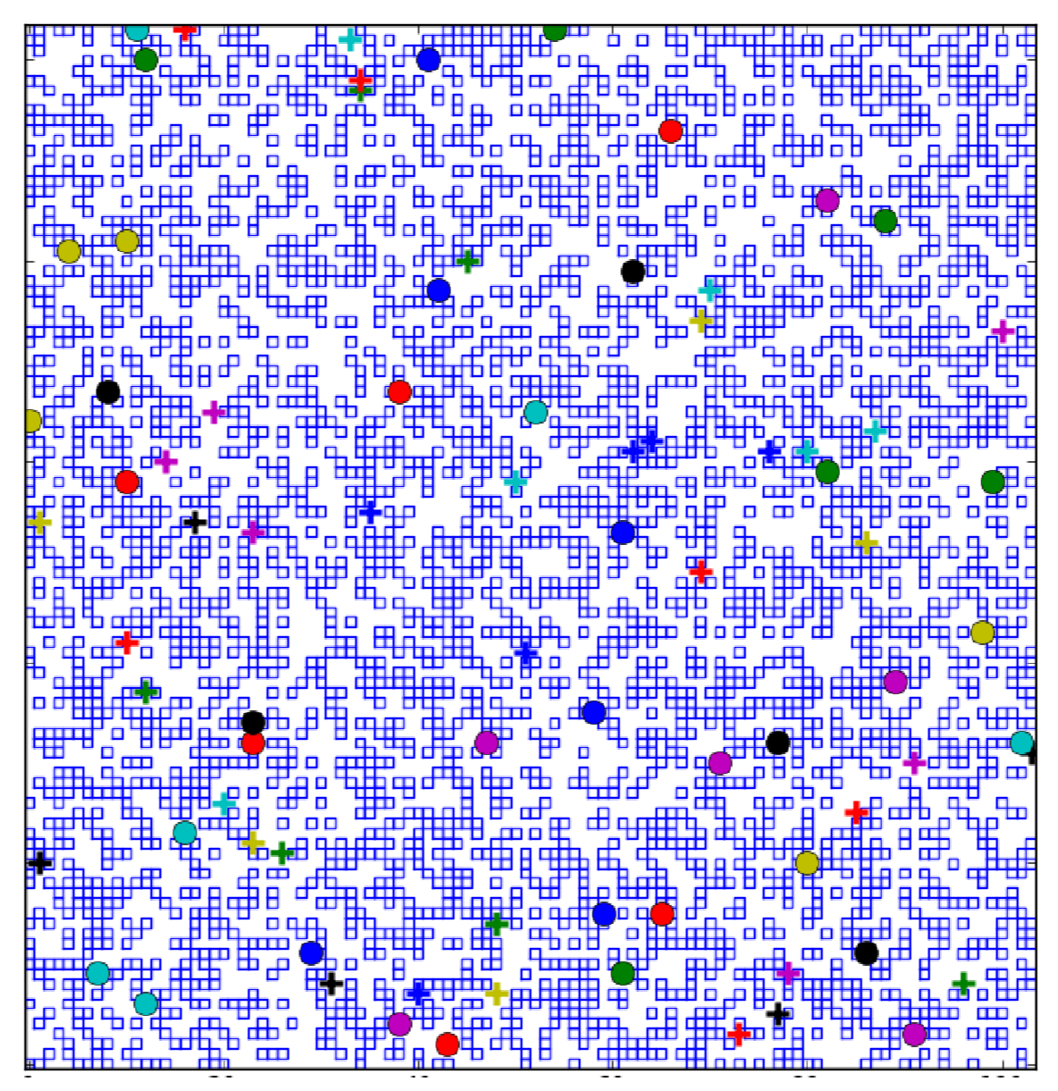
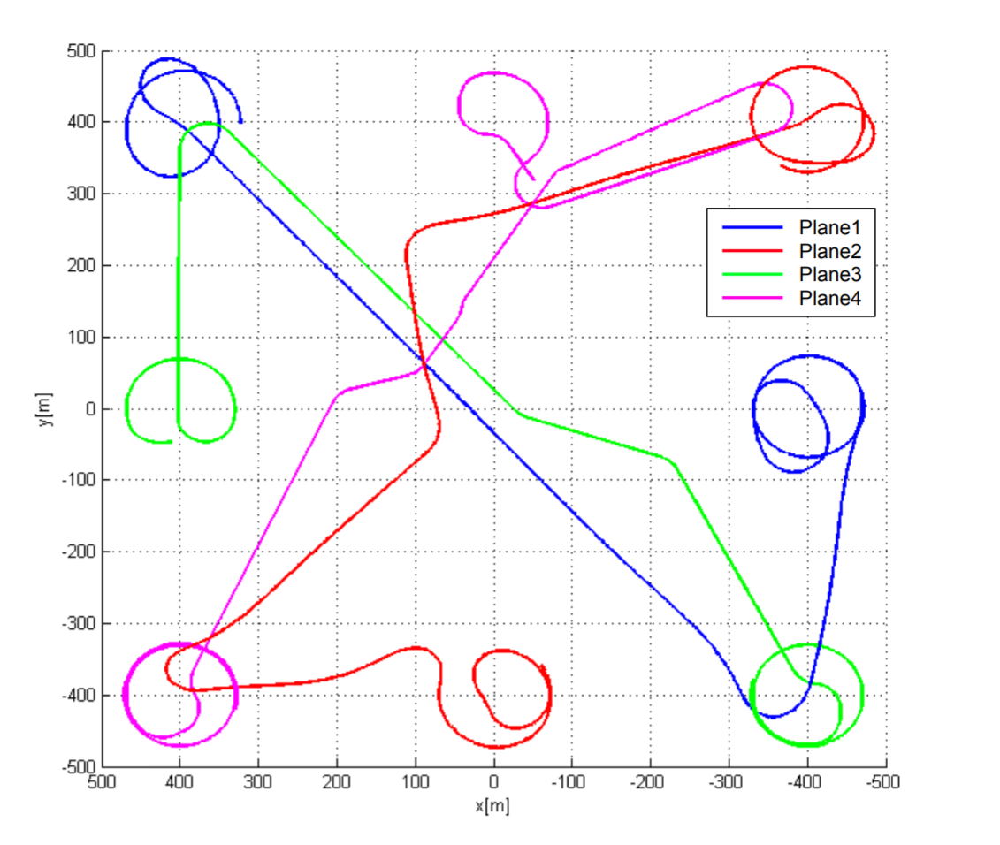
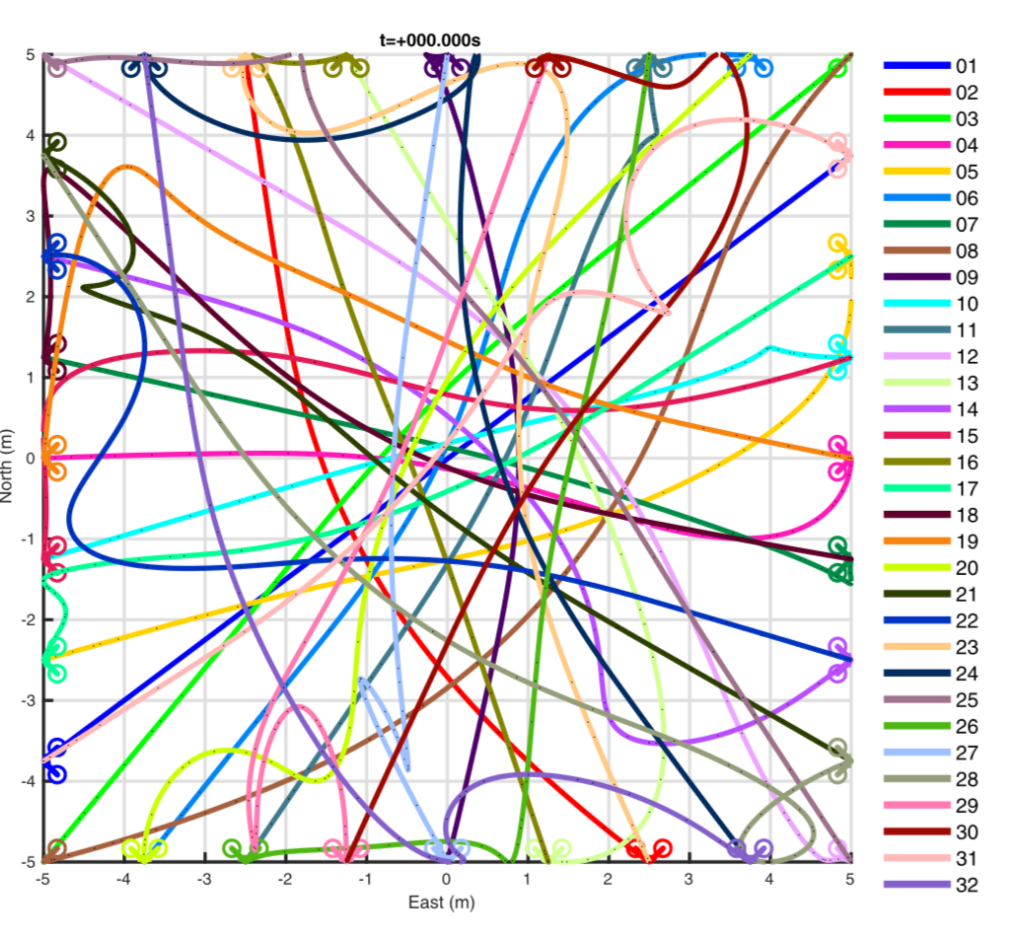
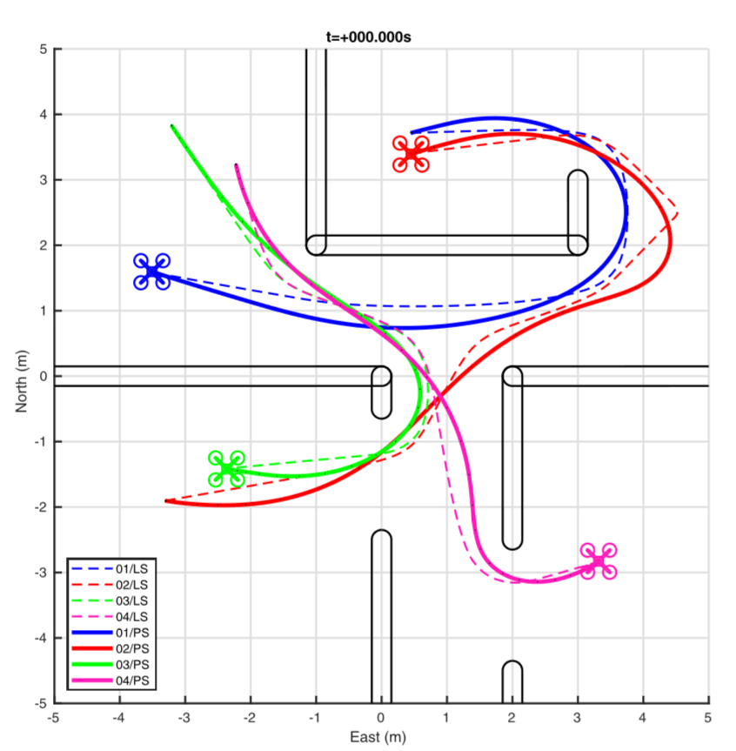
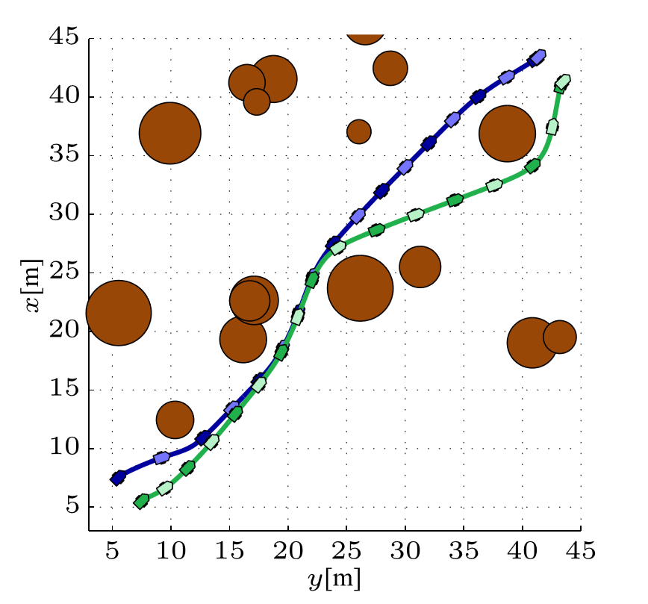
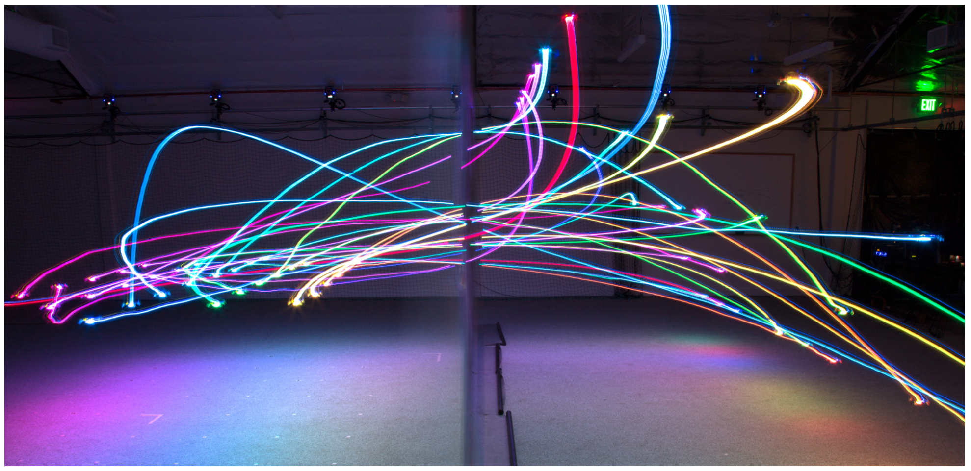
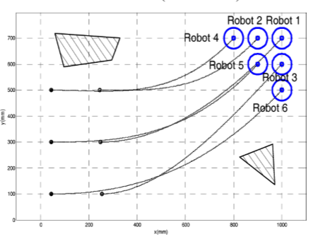
State-of-the-Art
Notes:
M* was a somewhat successful attempt made in 2011 to reduce the dimensionality of the search space by grouping the agents according to which ones could collide, while retaining the completeness and optimality of an A* solution [21]. The M* algorithm extended the practicality of coupled algorithms such that 10 robots could be planned for in under 5 minutes and 100 robots in under 25 minutes.
Moving in formations is the new challenge. Some centralized planning schemes such as that in [17] have proved successful, but all the computational limitations of centralized planners still exist for those solutions and the challenge remains for decentralized planners.
In 2013, a decentralized-decoupled post-planning algorithm (with priorities) was published which reduced the computation time via asynchronous planning, that is re-planning occurred as soon as individual robots completed their path plans, rather than waiting for all the robots to finish [35]. This algorithm was applied to a team of heterogeneous UAVs with “super conflicts” (which collisions of more than one agent) in simulation as well as in real life [35].
In 2016 a centralized-coupled algorithm was published which could create a time-continuous (variable step-size solver was used to discretize it after the fact) trajectory which minimized energy consumption as well as delay in arrival without making simplifying (linearizing) assumptions about the vehicle dynamics or constraints as most planners do [23].
In 2018, a two-phase planning method used a Level-Set method to initialize a piecewise-linear trajectory, and then a Pseudo-Spectral method to create a time-optimal trajectory with smooth jerk. This proved to be the fastest and could be applied to numerous robots, but it has only been implemented for simulated 2D spaces whereas the preceding methods were applied to 3D spaces on real robots. A similar two-phase piece-wise linear to smooth trajectory planner was successfully used for 3D motion planning for a team of 32 quadcopters in a cluttered environment but required a few minutes [58].

Slide 13

State-of-the-Art
Notes:
A similar planning method was implemented in a distributed fashion for a relatively large group of quadcopters moving in formation [59]. That algorithm was very recently extended for use on a heterogeneous team [60].

Slide 14


Review
Computation
Centralized
Decentralized
Communication
Explicit
Implicit
Task Allocation
Market-Based
Roles vs Tasks
Motion Planning
Coupled
Plan Merging
Decoupled
Active
Pre-Planning
Post-Planning
Iterative-Response
Passive
Notes:
Swarm robotics is a subset of multi-robot systems for large numbers of homogeneous robots which are controlled in a distributed fashion.
Centralize computation uses an off-board computer to control all the robots, and decentralized planning has each robot computing for itself. Centralized computation has the potential for completeness and optimality, whereas decentralized does not, but centralized planning is slower and poses a reliability risk.
Tasks must be divided among the robots and the most common method is to use a market-based auction where robots bid for a task. There are many variations of this approach. Team tasks and “complex” tasks are difficult to allocate. Roles are collections of tasks and could be useful in the assignments of heterogeneous teams.
Coupled planning treats all the robots as a system and thus accounts for inter-robot collisions while doing motion planning, and decoupled planning treats the robots as individuals and separately tries to coordinate their plans. Couple planning has the potential to be optimal and complete, whereas decoupled does not, but coupled planners are too slow for many real-time applications.
(Centralized and Decentralized computation to not necessarily correspond to coupled and decoupled planning, but often do). Decoupled planning can be done in several ways: pre-planning, post-planning, and iterative-response. There is also the option in certain applications to coordinate during plan execution.
There are limitations to communication which must be considered, which motives the use of distributed computation with local interaction as well as implicit communication via sensing.
Despite the massive amounts of research conducted in multi-agent planning, much is still to be done. An example of this is quadcopters, which have the potential for many multi-agent and swarm applications, but the current planning methods are far from perfected. Others areas of future research shall include the incorporation of formations and human-robot interactions.

Slide 15

Questions?

Slide 16
References
Cao, Y. Uny, Alex S. Fukunaga, and Andrew Kahng. "Cooperative mobile robotics: Antecedents and directions." Autonomous robots 4.1 (1997): 7-27.
Yan, Zhi, Nicolas Jouandeau, and Arab Ali Cherif. "A survey and analysis of multi-robot coordination." International Journal of Advanced Robotic Systems 10.12 (2013): 399.
Dias, M. Bernardine, et al. "Market-based multirobot coordination: A survey and analysis." Proceedings of the IEEE 94.7 (2006): 1257-1270.
Lavalle, Steven M. Planning Algorithms. Cambridge University Press, 2006, pp. 318-327,362-364.
Şahin, Erol. "Swarm robotics: From sources of inspiration to domains of application." International workshop on swarm robotics. Springer, Berlin, Heidelberg, 2004.
Campbell, Adam, and Annie S. Wu. "Multi-agent role allocation: issues, approaches, and multiple perspectives." Autonomous agents and multi-agent systems 22.2 (2011): 317-355.
Jia, Xiao, and Max Q-H. Meng. "A survey and analysis of task allocation algorithms in multi-robot systems." Robotics and biomimetics (ROBIO), 2013 IEEE international conference on. IEEE, 2013.
Cai, Yifan, and Simon X. Yang. "A survey on multi-robot systems." World Automation Congress (WAC), 2012. IEEE, 2012.
Torreño, Alejandro, et al. "Cooperative Multi-Agent Planning: A Survey." ACM Computing Surveys (CSUR) 50.6 (2017): 84.
De Weerdt, Mathijs, and Brad Clement. "Introduction to planning in multiagent systems." Multiagent and Grid Systems 5.4 (2009): 345-355.
Todt, Eduardo, G. Rausch, and Raúl Suárez. "Analysis and classification of multiple robot coordination methods." Robotics and Automation, 2000. Proceedings. ICRA'00. IEEE International Conference on. Vol. 4. IEEE, 2000.
Buckley, Stephen J. "Fast Motion Planning for Multiple Moving Robots." Robotics and Automation, 1989. Proceedings., 1989 IEEE International Conference on. IEEE, 1989.
Alami, Rachid, et al. "Multi-robot cooperation through incremental plan-merging." Robotics and Automation, 1995. Proceedings., 1995 IEEE International Conference on. Vol. 3. IEEE, 1995.
Arai, Tamio, Enrico Pagello, and Lynne E. Parker. "Advances in multi-robot systems." IEEE Transactions on robotics and automation 18.5 (2002): 655-661.
Van den Berg, Jur, Ming Lin, and Dinesh Manocha. "Reciprocal velocity obstacles for real-time multi-agent navigation." Robotics and Automation, 2008. ICRA 2008. IEEE International Conference on. IEEE, 2008.
Snape, Jamie, et al. "Independent navigation of multiple mobile robots with hybrid reciprocal velocity obstacles." Intelligent Robots and Systems, 2009. IROS 2009. IEEE/RSJ International Conference on. IEEE, 2009.
Tanner, Herbert G., and Amit Kumar. "Towards decentralization of multi-robot navigation functions." Robotics and Automation, 2005. ICRA 2005. Proceedings of the 2005 IEEE International Conference on. IEEE, 2005.
Liu, Shuang, Dong Sun, and Changan Zhu. "Coordinated motion planning for multiple mobile robots along designed paths with formation requirement." IEEE/ASME transactions on mechatronics 16.6 (2011): 1021-1031.
Van Den Berg, Jur P., and Mark H. Overmars. "Prioritized motion planning for multiple robots." Intelligent Robots and Systems, 2005.(IROS 2005). 2005 IEEE/RSJ International Conference on. IEEE, 2005.
Peasgood, Mike, Christopher Michael Clark, and John McPhee. "A complete and scalable strategy for coordinating multiple robots within roadmaps." IEEE Transactions on Robotics 24.2 (2008): 283-292.
Wagner, Glenn, and Howie Choset. "M*: A complete multirobot path planning algorithm with performance bounds." Intelligent Robots and Systems (IROS), 2011 IEEE/RSJ International Conference on. IEEE, 2011.
Burgard, Wolfram, et al. "Coordinated multi-robot exploration." IEEE Transactions on robotics 21.3 (2005): 376-386.
Häusler, Andreas J., et al. "Energy-optimal motion planning for multiple robotic vehicles with collision avoidance." IEEE Transactions on Control Systems Technology 24.3 (2016): 867-883.
Adams, Julie A. "Coalition formation for task allocation: Theory and algorithms." Autonomous Agents and Multi-Agent Systems 22.2 (2011): 225-248.
Faigl, Jan, Miroslav Kulich, and Libor Přeučil. "Goal assignment using distance cost in multi-robot exploration." Intelligent Robots and Systems (IROS), 2012 IEEE/RSJ International Conference on. IEEE, 2012.
Yeung, Dit-Yan, and George Bekey. "A decentralized approach to the motion planning problem for multiple mobile robots." Robotics and Automation. Proceedings. 1987 IEEE International Conference on. Vol. 4. IEEE, 1987.
Azarm, Kianoush, and Günther Schmidt. "Conflict-free motion of multiple mobile robots based on decentralized motion planning and negotiation." Robotics and Automation, 1997. Proceedings., 1997 IEEE International Conference on. Vol. 4. IEEE, 1997.
Alami, Rachid, Felix Ingrand, and Samer Qutub. "Planning coordination and execution in multi-robots environment." Advanced Robotics, 1997. ICAR'97. Proceedings., 8th International Conference on. IEEE, 1997.
Alami, Rachid, François Felix Ingrand, and Samer Qutub. "A Scheme for Coordinating Multi-robots Planning Activities and Plans Execution." ECAI. 1998.
Bennewitz, Maren, Wolfram Burgard, and Sebastian Thrun. "Optimizing schedules for prioritized path planning of multi-robot systems." Robotics and Automation, 2001. Proceedings 2001 ICRA. IEEE International Conference on. Vol. 1. IEEE, 2001.

Slide 17
References … Continued …
Zlot, Robert, et al. "Multi-robot exploration controlled by a market economy." Robotics and Automation, 2002. Proceedings. ICRA'02. IEEE International Conference on. Vol. 3. IEEE, 2002.
Michael, Nathan, et al. "Distributed multi-robot task assignment and formation control." Robotics and Automation, 2008. ICRA 2008. IEEE International Conference on. IEEE, 2008.
Song, Tao, et al. "A distributed bidirectional auction algorithm for multirobot coordination." Research Challenges in Computer Science, 2009. ICRCCS'09. International Conference on. IEEE, 2009.
Cui, Rongxin, Ji Guo, and Bo Gao. "Game theory-based negotiation for multiple robots task allocation." Robotica 31.6 (2013): 923-934.
Cáp, Michal, et al. "Asynchronous decentralized prioritized planning for coordination in multi-robot system." Intelligent Robots and Systems (IROS), 2013 IEEE/RSJ International Conference on. IEEE, 2013.
Kennedy J, Eberhart R. Particle swarm optimization. In: Proceedings of the IEEE international conference neural networks, Perth, Australia, 1995, vol. 4, p. 1942–8.
Ayari, Asma, and Sadok Bouamama. "A new multiple robot path planning algorithm: dynamic distributed particle swarm optimization." Robotics and Biomimetics 4.1 (2017): 8.
Bandyopadhyay, Saptarshi, Soon-Jo Chung, and Fred Y. Hadaegh. "Probabilistic and distributed control of a large-scale swarm of autonomous agents." IEEE Transactions on Robotics 33.5 (2017): 1103-1123.
Wu, Dan, and Huaicheng Su. "An improved probabilistic approach for collaborative multi-robot localization." Robotics and Biomimetics, 2008. ROBIO 2008. IEEE International Conference on. IEEE, 2009.
Jevtic, Aleksandar, et al. "Distributed bees algorithm for task allocation in swarm of robots." IEEE Systems Journal 6.2 (2012): 296-304.
Bandyopadhyay, Saptarshi, Soon-Jo Chung, and Fred Y. Hadaegh. "Probabilistic and distributed control of a large-scale swarm of autonomous agents." IEEE Transactions on Robotics 33.5 (2017): 1103-1123.
Madhavan, Raj, Kingsley Fregene, and Lynne E. Parker. "Distributed heterogeneous outdoor multi-robot localization." Robotics and Automation, 2002. Proceedings. ICRA'02. IEEE International Conference on. Vol. 1. IEEE, 2002.
Jones, Edward Gil, et al. "Dynamically formed heterogeneous robot teams performing tightly-coordinated tasks." Robotics and Automation, 2006. ICRA 2006. Proceedings 2006 IEEE International Conference on. IEEE, 2006.
Viguria, Antidio, Ivan Maza, and Anibal Ollero. "S+ T: An algorithm for distributed multirobot task allocation based on services for improving robot cooperation." Robotics and Automation, 2008. ICRA 2008. IEEE International Conference on. IEEE, 2008.
Di Paola, Donato, David Naso, and Biagio Turchiano. "Consensus-based robust decentralized task assignment for heterogeneous robot networks." American Control Conference (ACC), 2011. IEEE, 2011.
Yu, Huili, et al. "Probabilistic path planning for cooperative target tracking using aerial and ground vehicles." American Control Conference (ACC), 2011. IEEE, 2011.
Di Paola, Donato, et al. "Decentralized dynamic task planning for heterogeneous robotic networks." Autonomous Robots 38.1 (2015): 31-48.
ndeger, Cagatay, and Faruk Polat. "Multi-agent real-time pursuit." Autonomous Agents and Multi-Agent Systems 21.1 (2010): 69-107.
Wawerla, Jens, and Richard T. Vaughan. "A fast and frugal method for team-task allocation in a multi-robot transportation system." Robotics and Automation (ICRA), 2010 IEEE International Conference on. IEEE, 2010.
Luna, Ryan, and Kostas E. Bekris. "Efficient and complete centralized multi-robot path planning." Intelligent Robots and Systems (IROS), 2011 IEEE/RSJ International Conference on. IEEE, 2011.
Dono, Thomas F., and Timothy H. Chung. "Optimized transit planning and landing of aerial robotic swarms." Robotics and Automation (ICRA), 2013 IEEE International Conference on. IEEE, 2013.
D. Mellinger and V. Kumar. Minimum snap trajectory generation and control for quadrotors. In Proc. of the IEEE Int. Conf. on Robotics and Automation, May 2011.
D. Mellinger, A. Kushleyev, and V. Kumar, “Mixed-integer quadratic program trajectory generation for heterogeneous quadrotor teams,” in Proc. IEEE Int. Conf. Robot. Autom., May 2012, pp. 477–483.
F. Augugliaro, A. P. Schoellig, and R. D’Andrea, “Generation of collision free trajectories for a quadrocopter ﬂeet: A sequential convex programming approach,” in Proc. IEEE/RSJ Int. Conf. Intell. Robots Syst., Oct. 2012, pp. 1917–1922.
Y. Chen, M. Cutler, and J. P. How, “Decoupled multiagent path planning via incremental sequential convex programming,” in Proc. IEEE Int. Conf. Robot. Autom., May 2015, pp. 5954–5961.
Kushleyev, Alex, et al. "Towards a swarm of agile micro quadrotors." Autonomous Robots 35.4 (2013): 287-300.
Mulgaonkar, Yash, et al. "Robust Aerial Robot Swarms Without Collision Avoidance." IEEE Robotics and Automation Letters 3.1 (2018): 596-603.
Preiss, James A., et al. “Downwash-Aware Trajectory Planning for Large Quadcopter Teams.” arXiv preprint arXiv:1704.04852 (2017).
Preiss, James A., et al. "Crazyswarm: A large nano-quadcopter swarm." Robotics and Automation (ICRA), 2017 IEEE International Conference on. IEEE, 2017.
Debord, mark. “Heterogeneous Trajectory Planning with Crazyflie and BigQuad Deck.” Bitcraze, USC ACT Lab, 2 Apr. 2018, www.bitcraze.io/2018/04/heterogeneous-trajectory-planning-with-crazyflie-and-bigquad-deck/.

Slide 18


